Slide 1
Engineering Failures (And how we might avoid them)
ELEG 491
Spring 2020

Slide 2
3 approaches
Monteiro- an (idealistic) Designer’s Code of Ethics: (designer is responsible for purpose as well as form)
Brey- an “anticipatory” ethics of forecasting (designer must foresee ethical issues & correct)
Regalado & Blyler- a retrospective “worst of” case-studies approach
Other ways: see supplementary readings: Joy, Moor

Slide 3
Where is the “ethics filter” between science/engineering and commercial development and distribution? The traditional view:
Basic Science
Very little “anticipatory” ethics, idealistic ethics, etc. required
Engineering and Technology
Some ethical issues arise in labs and w/industry collaboration
Commercial development and distribution
Ethics of third-party effects, unjust distributions, etc.

Slide 4
What kinds of filters are there? How do they vary? What gets through and what gets stopped?
consumer and insurance markets
Regulations, taxes, incentives, IP, potential lawsuits
Ethics: individual/social &
cultural values, future humans
the environment, etc.

Slide 5
Consider the problem from an “ecological” perspective
Aldo Leopold (A Sand County Almanac, 1949):
“Politics and economics are advanced symbioses in which the original free-for-all competition has been replaced, in part, by co-operative mechanisms with an ethical content…. The complexity of co-operative mechanisms has increased with population density, and with the efficiency of tools. It was simpler, for example, to define the anti-social uses of sticks and stones in the days of the mastodons than of bullets and billboards in the age of motors.”

Slide 6
Leopold (cont.)
“Evolutionary changes… are usually slow and local. Man' s invention of tools has enabled him to make changes of unprecedented violence, rapidity, and scope.”
Evidence for this view? The Anthropocene

Slide 7
There is a (relatively) long history of scientists and inventors warning of the dangers of what they invent
Robert Oppenheimer’s address to the American Philosophical Society (11-16-45)
“…we have made a thing, a most terrible weapon, that has altered abruptly and profoundly the nature of the world. We have made a thing that, by all standards of the world we grew up in, is an evil thing. By so doing, by our participation in making it possible to make these things, we have raised again the question of whether science is good for man, of whether it is good to learn about the world, to try to understand it, to try to control it, to help gift to the world of men increased insight, increased power…. Because we are scientists, we must say an unalterable "yes" to these questions. It is our faith and our commitment, seldom made explicit, even more seldom challenged that knowledge is a good in itself. Knowledge and such power as must come with it.”

Slide 8
Jim Moor’s analysis of technological revolutions and the need for ethics
Distinguishes technological devices, implementations, and paradigms from…Revolutions!
He analyzes: Introduction, Permeation, and Power stages
Brey wants to introduce a prior ”R&D” stage of analysis

Slide 9
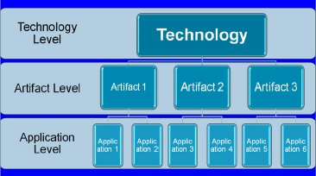
Brey’s 3 Level Approach to “Anticipation”

Slide 10
Some useful definitions from Brey
Technology: a collection of techniques that are related to each other because of a common purpose, domain, or formal or functional features. (e.g., nuclear, nano)
Technique: a procedure to accomplish a speciﬁc activity or task.

Slide 11
More definitions
Artifact: a physical conﬁguration that, when operated in the proper manner and in the proper environment, produces a desired result
Application: the concrete use of a technological artifact or procedure for a particular purpose or in a particular context, or a speciﬁc conﬁguration of an artifact to enable it to be used in a certain way

Slide 12




The problem of uncertainty: an analogy for thinking about risk and precaution:
Many technologies have promise to create profits and provide solutions for energy, food& water, medicine, security, and other needs.
We know very little about the “worst-case scenario” for some technologies.
The choice between Brey’s “generic” and “anticipatory” approaches must consider public perception and acceptance, and what we stand to lose.

Slide 13
Brey’s ethical checklist (major categories)
Harms and risks
Rights
Autonomy
Human Dignity
Privacy
Property
Justice
Well-being and the Common Good

Slide 14
Bill Joy’s warning in “Why the Future Doesn’t Need Us” (WIRED 2000)
“Kaczynski's dystopian vision describes unintended consequences, a well-known problem with the design and use of technology, and one that is clearly related to Murphy's law – ‘Anything that can go wrong, will.’
…
“The 21st-century technologies - genetics, nanotechnology, and robotics (GNR) - are so powerful that they can spawn whole new classes of accidents and abuses. Most dangerously, for the first time, these accidents and abuses are widely within the reach of individuals or small groups. They will not require large facilities or rare raw materials. Knowledge alone will enable the use of them.”

Slide 15
Stuart Russell’s comparison of AI and nuclear weaponry
Q: The intention with fission was to create a weapon. The intention with AI is to create a tool: intelligence on tap. Does that explain the reluctance to regulate AI?
A: From the beginning, the primary interest in nuclear technology was the “inexhaustible supply of energy.” The possibility of weapons was also obvious. I think there is a reasonable analogy between unlimited amounts of energy and unlimited amounts of intelligence. Both seem wonderful until one thinks of the possible risks. In neither case will anyone regulate the mathematics. The regulation of nuclear weapons deals with objects and materials, whereas with AI it will be a bewildering variety of software that we cannot yet describe. I’m not aware of any large movement calling for regulation either inside or outside AI, because we don’t know how to write such regulation.
(Bohannon, J. (2015) ”Fears of an AI Pioneer” Science July 15, 2015, 349:6245, pp. 252)

Slide 16
Case Study: Ethical Issues in Nanoscience (NS) and Nanotechnology (NT)
Engineered nanoparticles (particles with one dimension between 1-100nm) have novel properties compared to bulk counterparts.
There are over 1,600 NT products now in the marketplace.
Since 2001, the U.S. federal government has supported NS and NT research with $25 billion for R&D, but research on environment, health, safety, and the ethical, legal, and social implications of NT accounts for only a few million a year.

Slide 17

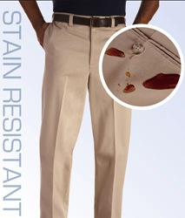

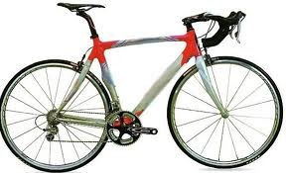
Some products seem trivial—but profitable!
Notes:
Engineered nanoparticles may soon become critical in new materials to save lives and heal the environment—outcomes far more important than the stain-resistant pants and bouncier tennis balls produced by the first generation of nanotechnologies. What about the potential downside? Like every technology, nanotechnology has risks, and much remains unknown about short-and long-term consequences for human health, air and water quality, agriculture, and a host of other things we care about.

Slide 18
What ethical responsibilities do scientists and engineers have for NT?
Our state of partial ignorance: not much is known about NP fate, characterization, transport, life-cycle, reactivity, toxicity.
On the one hand: ought implies can! Moral obligations on scientists apply only to the extent that they can know enough to protect the public.
On the other: willful ignorance is not a good excuse! Effects on human health and environment must be researched along with basic science and engineering.

Slide 19
Some ethical considerations for nanotechnologies
Could individual privacy be harmed by NT surveillance devices?
Should we spend money for nonessential medicine-- physiological/cognitive human enhancement?
Will NT pollution or even “grey goo” from production/consumption be left for future generations to clean up?
Will more R&D go to the production of leisure goods instead of addressing urgent problems?
Could products for environmental sensing cause more environmental stress than they alleviate?

Slide 20

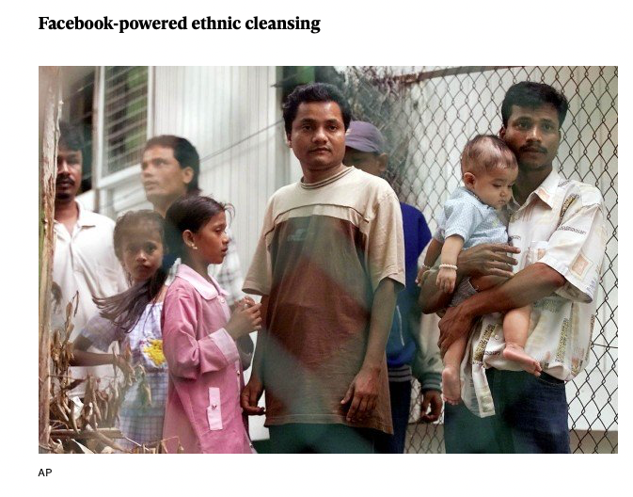
Some cases of ”failures” 2018-19

Slide 21
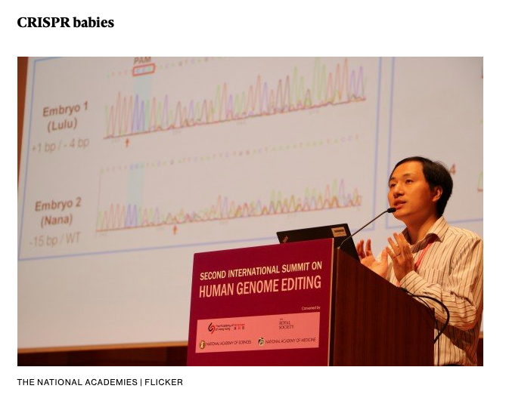
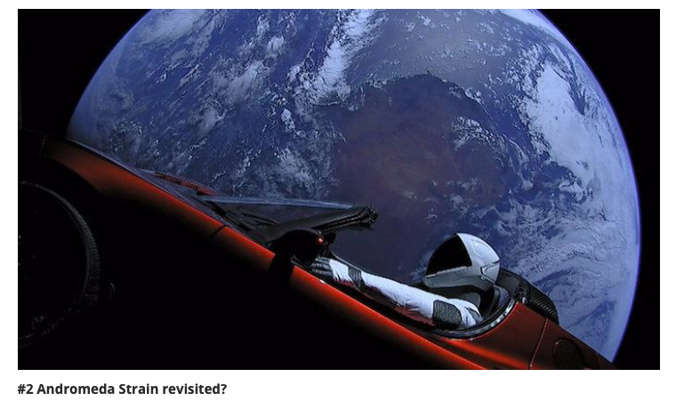
More “failures”

Slide 22
How to meet the challenges of the 21st century: more technology or less?
“For this century-long journey, we will need more technology, not less. As the world’s population grows to 10 billion or more, we recognize that nature cannot be shielded perfectly from human intervention any more than we can be shielded perfectly from nature. But technological change can relax our grip and lighten our tread on the natural world. Our choices are constrained by what already exists and the environmental legacy of the past. But over the long term the capacity for social choices to shape technology is endless.”
(Arnulf Gruebler, Technology and Global Change. Cambridge University Press:Cambridge, England, 1998)
Notes:
Stop here if time permits

